Slide 1
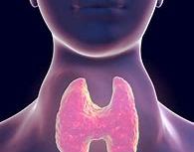
Thyroid disease detection / Prediction
- Shantanu Kukkar

Slide 2
INTRODUCTION
Thyroid disease a very common problem in India, more than one crore people are suffering with the disease every year. Especially it is more common in female. Hyperthyroidism and hypothyroidism are the most two common diseases caused by irregular function of thyroid gland. Thyroid disorder can speed up or slow down the metabolism of the body. In the world of rising new technology and innovation, healthcare industry is advancing with the role of Artificial Intelligence. Machine learning algorithms can help to early detection of the disease and to improve the quality of the life. This study demonstrates the how different classification algorithms can forecasts the presence of the disease. Different classification algorithms such as Logistic regression, Random Forest, Decision Tree, Naïve Bayes, Support Vector Machine have been tested and compared to predict the better outcome of the model.

Slide 3
OBJECTIVE
The main goal of this project is to predict the risk of hyperthyroid and hypothyroid based on various factors of individuals. Thyroid disease is a common cause of medical diagnosis and prediction, with an onset that is difficult to forecast in medical research. It will play a decisive role in order to early detection, accurate identification of the disease and helps the doctors to make proper decisions and better treatment.

Slide 4
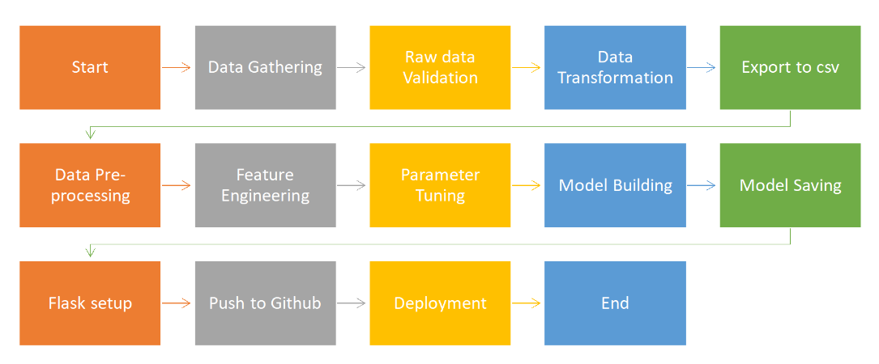
ARCHITECTURE

Slide 5
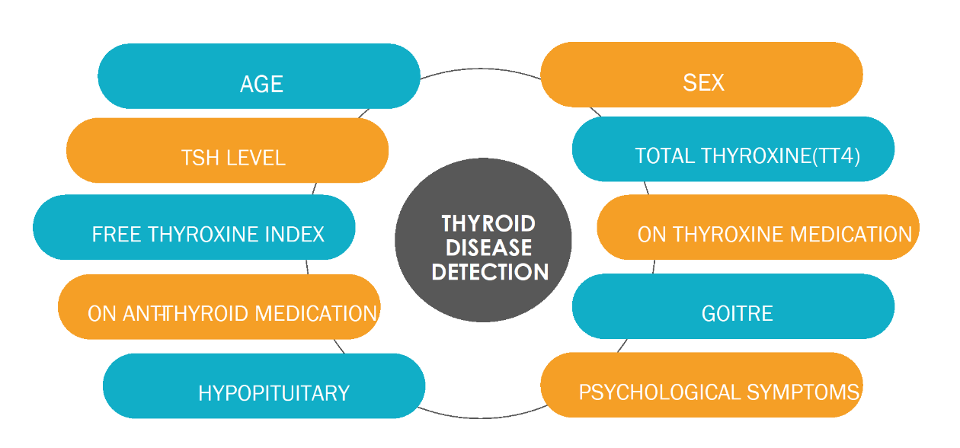
DATA SET

Slide 6
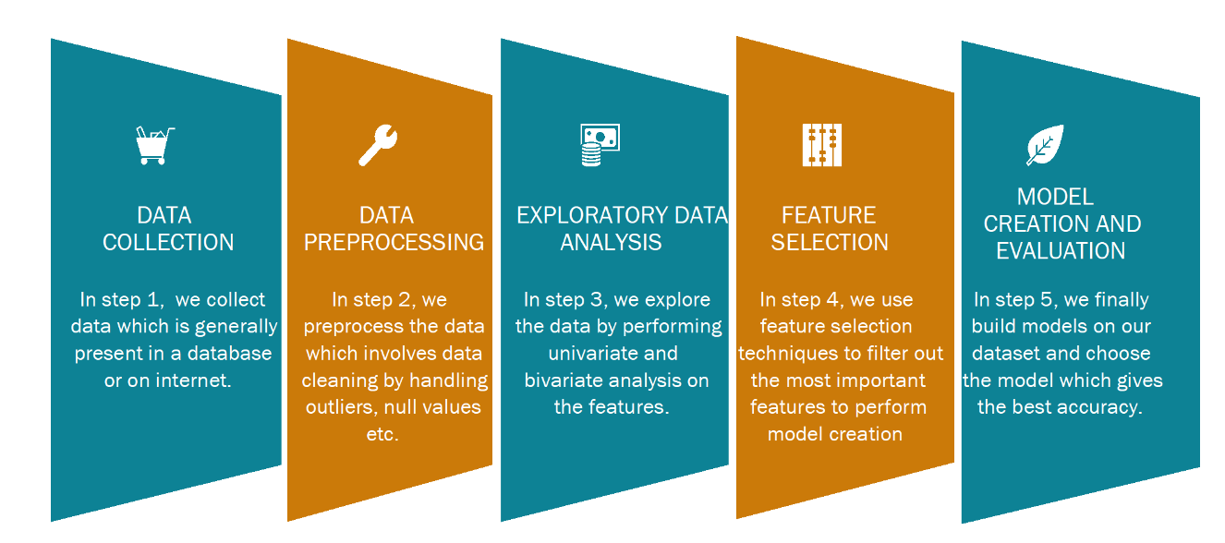
DATA ANALYSIS STEPS

Slide 7
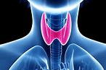
THANK YOU
- Shantanu Kukkar

